Slide 1
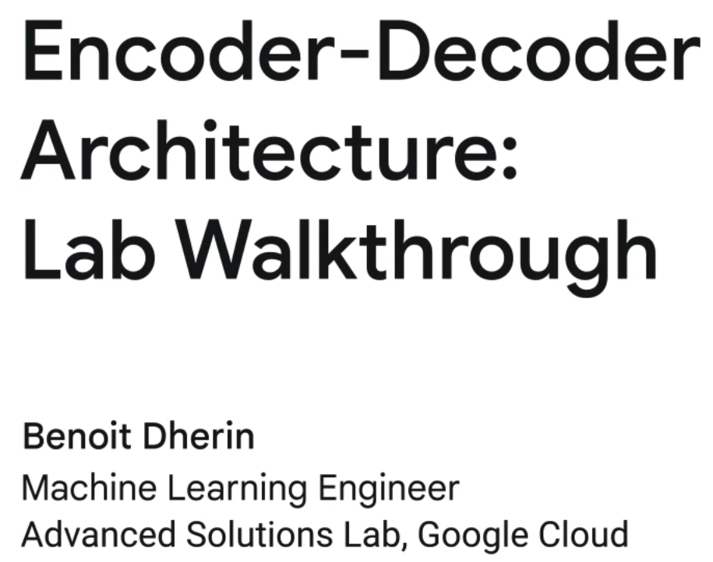

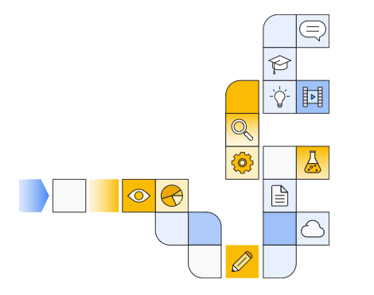

Notes:
https://www.cloudskillsboost.google/paths/183/course_templates/543

Slide 2

Notes:
https://www.youtube.com/watch?v=a-0NKtdXnCQ

Slide 3

Notes:
https://github.com/GoogleCloudPlatform/asl-ml-immersion/blob/master/notebooks/text_models/solutions/text_generation.ipynb

Slide 4
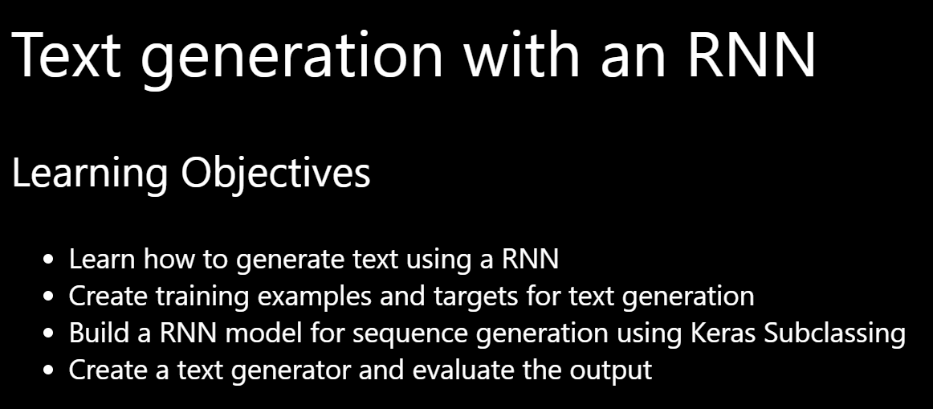

Slide 5


Slide 6
cuda support (optional)

Slide 7

Create a new environment

Slide 8
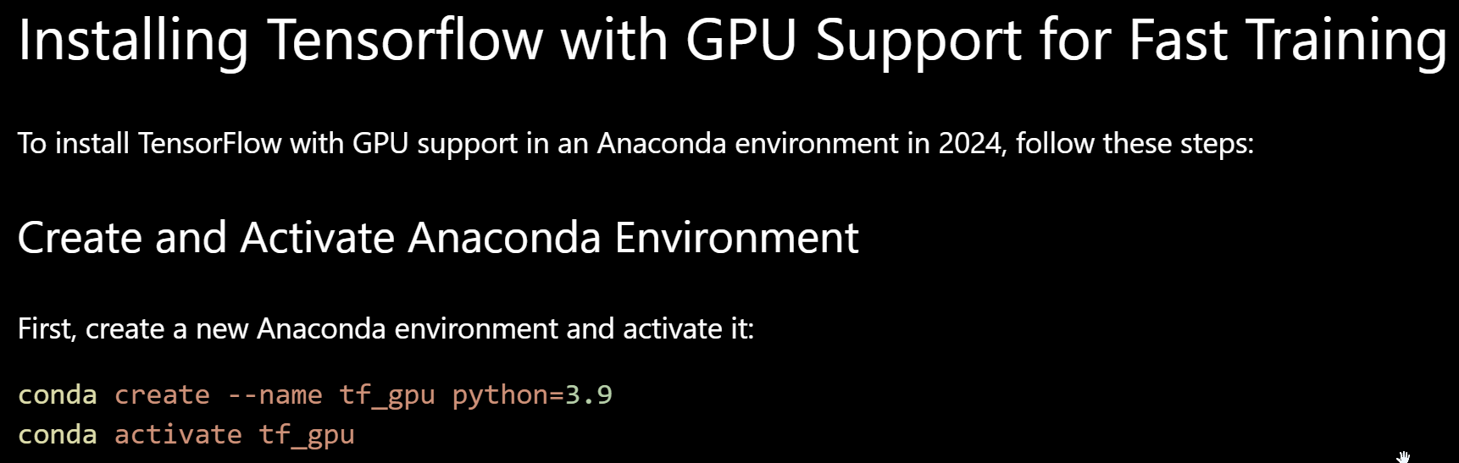
Notes:
conda create --name tf_gpu python=3.9
conda activate tf_gpu

Slide 9


Slide 10
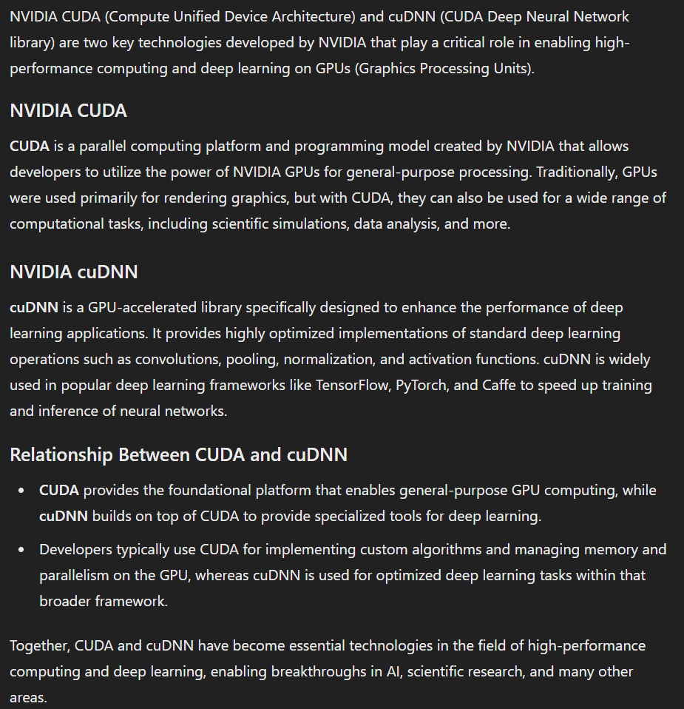

Slide 11
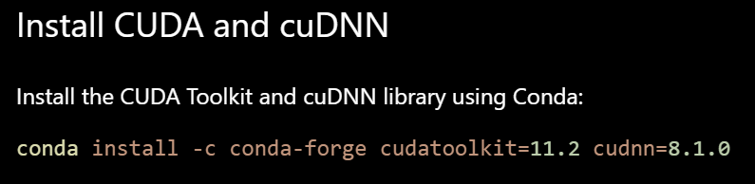
Notes:
conda install -c conda-forge cudatoolkit=11.2 cudnn=8.1.0

Slide 12


Slide 13
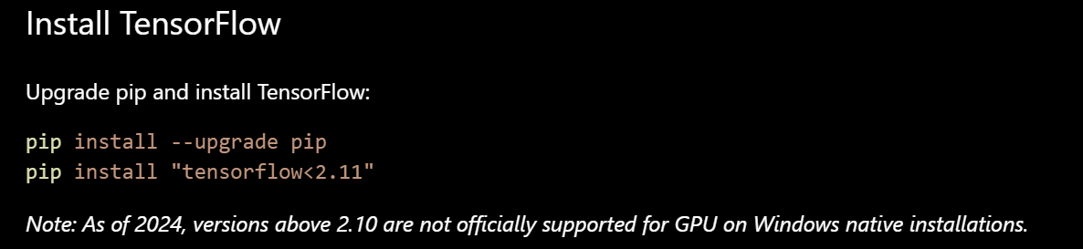
Notes:
pip install --upgrade pip
pip install "tensorflow<2.11"

Slide 14
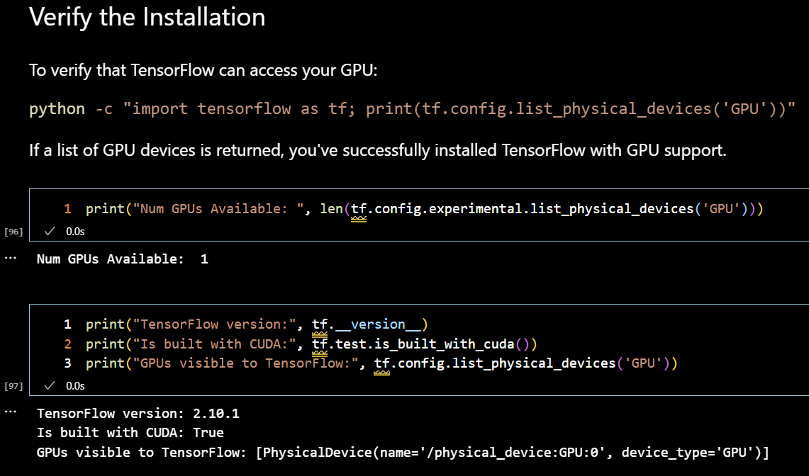
Notes:
python -c "import tensorflow as tf; print(tf.config.list_physical_devices('GPU'))"

Slide 15
Notebook walkthrough

Slide 16
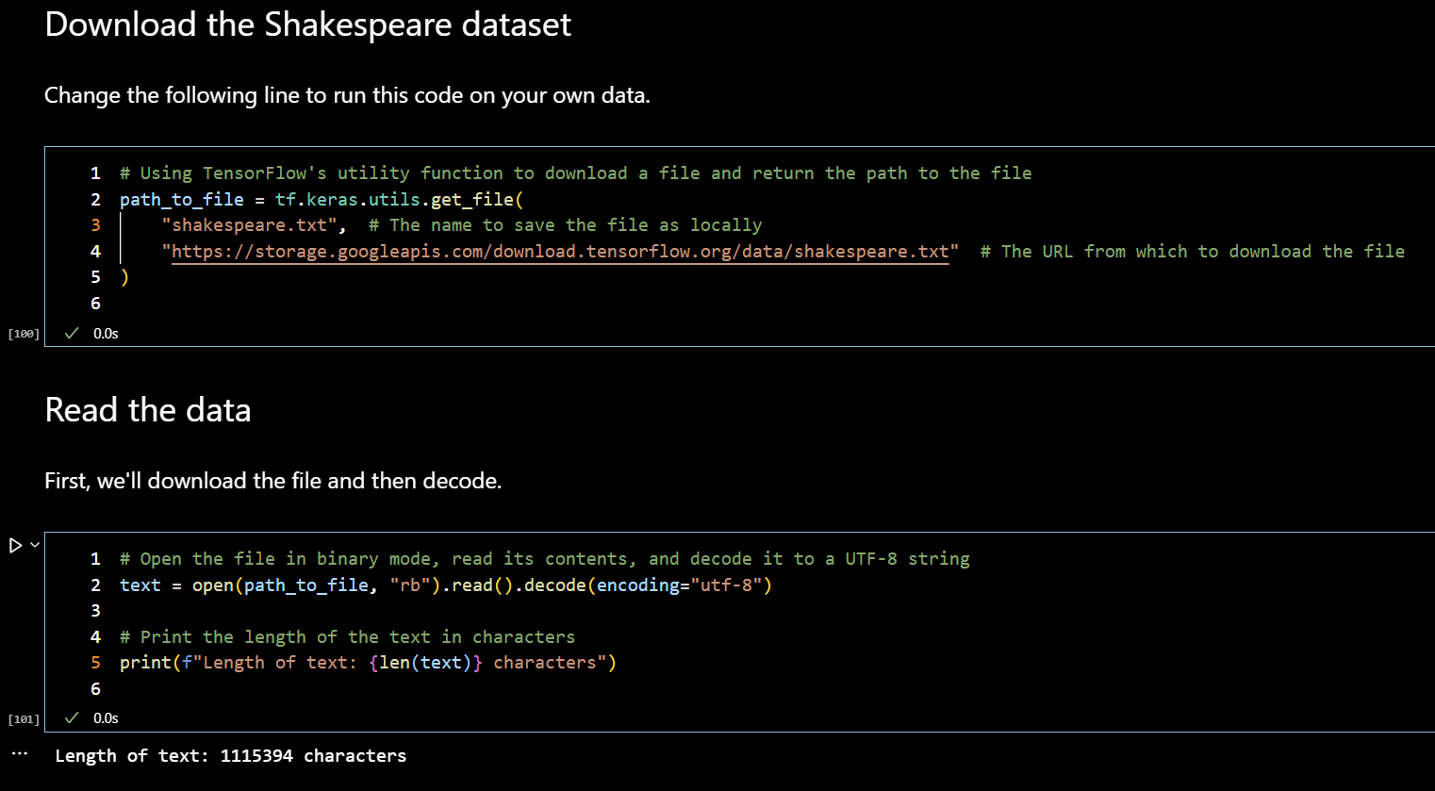

Slide 17


